Slide 1
Preeclampsia
Group Members:
Date:

Slide 2

Introduction
Hypertension during pregnancy is a major risk.
Common forms of hypertension is:
Pre-eclampsia - high blood pressure during pregnancy
This 15-minutes presentation targets nursing students and instructor
To widen understanding of preeclampsia; pathophysiology and interventions.
Notes:
Hypertension during pregnancy presents a substantial risk, with pre-eclampsia being a common and severe form of the disorder (Dimitriadis et al. 2023). It is characterized by elevated blood pressure after 20 weeks of gestation, often accompanied by proteinuria and organ dysfunction. This presentation, tailored for nursing students and instructors, aims to enhance understanding of pre-eclampsia, encompassing its pathophysiology and interventions. Its primary objective is to understand pre-eclampsia, its underlying pathophysiological mechanisms, and various interventions available for its prevention and management. Through an in-depth exploration of pre-eclampsia, students will gain a deeper understanding of its complexities and interventions.

Slide 3

Learning Objectives
By the end of this presentation, students should be able to:
Define preeclampsia and its pathophysiology.
Identify and explain two nursing problems associated with pre-eclampsia.
Demonstrate understanding of at 5 evidence-based interventions for problems identified.
Notes:
By the end of this presentation, students should be able to:
Define pre-eclampsia and elucidate its pathophysiological mechanisms, including the role of abnormal placentation and maternal vascular dysfunction in its development.
Identify and explain two nursing problems commonly associated with pre-eclampsia, such as hypertension, Impaired Placental Perfusion, and Risk of HELLP Syndrome (Hemolysis, Elevated Liver Enzymes, Low Platelet Count)
Demonstrate understanding of at least five evidence-based interventions for the nursing problems identified.

Slide 4
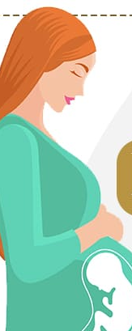
Preeclampsia
Preeclampsia
hypertension and vasospasms due to reduced resistance to angiotensin (Dimitriadis et al. 2023).
Angiotensin - a peptide hormone that regulates blood pressure
Symptoms
high blood pressure (hypertension)
proteinuria (presence of protein in the urine)
decreased renal perfusion,
retention of sodium and high creatinine
Risk Factors
history of high blood pressure (Wainstock et al. 2020)
kidney disease, diabetes, obesity
family history of preeclampsia
Notes:
Preeclampsia is a serious hypertensive disorder that occurs during pregnancy, typically after the 20th week ((Dimitriadis et al. 2023; Wheeler et al. 2022). It is characterized by high blood pressure (hypertension) and proteinuria (presence of protein in the urine). Preeclampsia poses significant risks to both the pregnant individual and the fetus due to its potential to affect various organs, including the kidneys, liver, and placenta. Without proper management, it can lead to severe complications, including eclampsia, which involves seizures.
Individuals with preeclampsia may experience symptoms such as elevated blood pressure (typically above 140/90 mmHg) and proteinuria. The condition can also impair kidney function, resulting in decreased renal perfusion, retention of sodium, and increased levels of creatinine, blood urea nitrogen (BUN), and uric acid. Preeclampsia can affect the blood supply to the placenta, leading to complications such as fetal growth restriction and preterm birth.
Certain risk factors may predispose individuals to develop preeclampsia, including a history of high blood pressure, kidney disease, diabetes, expecting multiples, family history of preeclampsia, autoimmune conditions like lupus, and obesity (Wainstock et al. 2020).

Slide 5
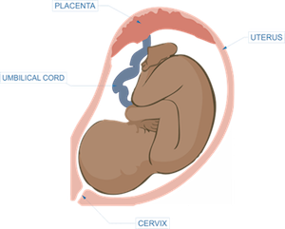
Nursing Diagnoses/Problems
Impaired Placental Perfusion:
inadequate blood flow to the placenta,
decreased oxygen and nutrient delivery to the fetus.
decreased flow of wastes from fetus
Signs and Symptoms:
fetal distress (abnormal fetal movement or heart rate patterns)
intrauterine growth restriction (IUGR),
oligohydramnios (reduced amniotic fluid volume)
Notes:
Impaired Placental Perfusion:
Impaired placental perfusion refers to inadequate blood flow to the placenta, resulting in decreased oxygen and nutrient delivery to the fetus and the flow of wastes from the fetus (Dimitriadis et al. 2023). Placental perfusion is crucial for fetal development and growth. Impaired perfusion can lead to fetal hypoxia, growth restriction, and even fetal demise (Wheeler et al. 2022).
The Signs and Symptoms may include fetal distress (such as decreased fetal movement or abnormal fetal heart rate patterns), intrauterine growth restriction (IUGR), and oligohydramnios (reduced amniotic fluid volume).

Slide 6
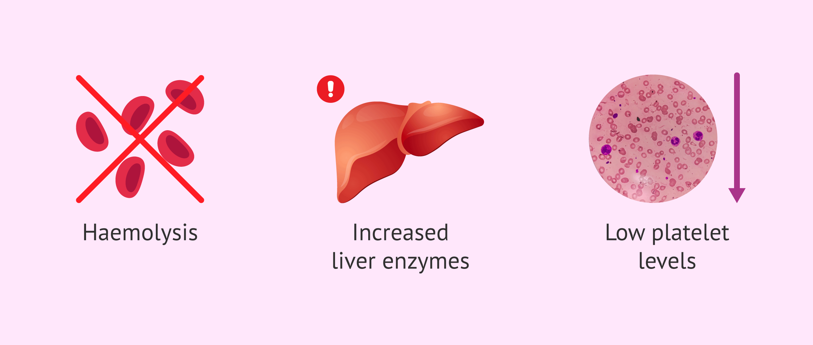
Nursing Diagnoses/Problems
Risk of HELLP Syndrome (Hemolysis, Elevated Liver Enzymes, Low Platelet Count)
hemolysis (breakdown of red blood cells)
elevated liver enzymes
low platelet count – high risk of bleeding
risk of liver rupture, hemorrhage, and multi-organ failure.
Signs and Symptoms:
abdominal pain
nausea and vomiting, headache
visual disturbances, hypertension.
Notes:
Risk of HELLP Syndrome (Hemolysis, Elevated Liver Enzymes, Low Platelet Count):
HELLP syndrome is a severe complication of preeclampsia characterized by hemolysis (breakdown of red blood cells), elevated liver enzymes, and low platelet count (Dimitriadis et al. 2023). HELLP syndrome can lead to life-threatening complications such as liver rupture, hemorrhage, and multi-organ failure. Early recognition and intervention are essential to prevent adverse outcomes.
The signs and symptoms may include abdominal pain (especially in the right upper quadrant), nausea and vomiting, headache, visual disturbances, epigastric pain, and hypertension (Wheeler et al. 2022). Laboratory findings may show evidence of hemolysis (e.g., elevated lactate dehydrogenase, low haptoglobin), liver dysfunction (elevated liver enzymes such as AST and ALT), and thrombocytopenia (low platelet count).

Slide 7

Interventions: Impaired Placental Perfusion
Aspirin Prophylaxis (Dimitriadis et al. 2023)
Calcium Supplementation
Uterine Artery Ultrasonography
Angiogenic Biomarker Assessment
Close Monitoring of Blood Pressure
Notes:
Aspirin prophylaxis is a notable intervention to mitigate impaired placental perfusion in pre-eclampsia (Dimitriadis et al. 2023). Initiating low-dose aspirin therapy early in pregnancy can effectively reduce the risk of pre-eclampsia among high-risk individuals. This intervention can enhance placental vascular function and promote optimal blood flow, potentially reducing the incidence and severity of pre-eclampsia.
Calcium supplementation and adequate calcium intake during pregnancy may contribute to better uteroplacental circulation, reducing the risk of pre-eclampsia (Wainstock et al. 2020).
Uterine artery ultrasonography is a diagnostic tool for assessing placental perfusion by evaluating uteroplacental blood flow (Wheeler et al. 2022). This intervention involves measuring parameters such as pulse rate and resistance index, which can provide valuable insights into the adequacy of placental perfusion and identify individuals at increased risk of pre-eclampsia. Early detection of abnormal uterine arteries can prompt timely intervention and monitoring to optimize maternal and fetal outcomes.
Assessing angiogenic biomarkers, such as soluble Fms-related receptor tyrosine kinase 1 (sFLT1) and placental growth factor (PGF), can aid in predicting and monitoring impaired placental perfusion in pre-eclampsia (Dimitriadis et al. 2023). Elevated levels of sFLT1 and decreased levels of PGF have been associated with endothelial dysfunction and poor placental perfusion. Therefore, monitoring these biomarkers during pregnancy can help identify individuals at increased risk of pre-eclampsia and guide clinical management decisions.
Close blood pressure monitoring is essential in managing impaired placental perfusion in pre-eclampsia. Elevated blood pressure is a hallmark feature of pre-eclampsia and can indicate inadequate placental perfusion and maternal organ dysfunction. Regular blood pressure monitoring allows for early detection of hypertension and prompt initiation of interventions, such as antihypertensive therapy, to mitigate the risk of adverse maternal and fetal outcomes associated with pre-eclampsia.

Slide 8

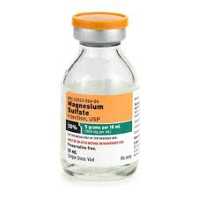
Interventions: HELLP Syndrome
Early Recognition and Diagnosis
Intravenous Magnesium Sulfate (MgSO4)
Blood Transfusion (Dimitriadis et al. 2023)
Corticosteroid Administration
Immediate Delivery in Severe Cases
Notes:
Early recognition and diagnosis of HELLP syndrome are crucial for timely intervention and prevention of complications. Prompt identification of clinical signs and symptoms, such as right-upper quadrant or epigastric pain, elevated liver enzymes, and thrombocytopenia, allows healthcare providers to initiate appropriate management strategies promptly.
Intravenous magnesium sulfate (MgSO4) administration is beneficial in managing HELLP syndrome. Magnesium sulfate helps to prevent seizures, a potentially life-threatening complication of severe pre-eclampsia and HELLP syndrome, by acting as a central nervous system depressant and reducing neuronal excitability. Additionally, magnesium sulfate has vasodilatory effects, which may improve placental perfusion and mitigate the risk of maternal complications.
In cases of severe HELLP syndrome with significant hemolysis and thrombocytopenia, blood transfusion may be necessary to correct anemia and coagulopathy. Timely blood transfusion can restore hematological parameters and prevent complications such as hemorrhage and disseminated intravascular coagulation.
The administration of corticosteroids, such as dexamethasone or betamethasone, can promote fetal lung maturation and reduce the risk of neonatal respiratory distress syndrome. Antenatal corticosteroid administration improves neonatal outcomes and reduces the risk of preterm birth in cases of severe HELLP syndrome.
In severe cases of HELLP syndrome with maternal and fetal compromise, immediate delivery is often the preferred management strategy to prevent further deterioration and mitigate the risk of adverse outcomes.

Slide 9

Evaluation of Audience Learning
Question and Answer Session
Peer Assessments
Rubric-Based Evaluation
Interactive Activities
Notes:
Conducting a question-and-answer session at the end allows students to clarify any uncertainties and reinforce their understanding of the presentation. For example, open-ended questions such as "Can anyone explain pre-eclampsia?" or "What are some evidence-based interventions for managing impaired placental perfusion?"
Peer assessments involve students evaluating each other's understanding and performance. Divide participants into small groups and assign them specific tasks related to the presentation. For instance, ask each group to discuss and evaluate the effectiveness of different interventions for HELLP syndrome.
Provide participants with a rubric outlining the learning objectives and criteria for assessment. Based on the rubric's criteria, ask them to self-assess their knowledge and skills.
Incorporate interactive activities. For instance, present a hypothetical case of a pregnant patient with symptoms of pre-eclampsia and ask students to collaboratively develop a care plan, including interventions and management strategies.

Slide 10
References
Dimitriadis, E., Rolnik, D. L., Zhou, W., Estrada-Gutierrez, G., Koga, K., Francisco, R. P., ... & Menkhorst, E. (2023). Pre-eclampsia. Nature Reviews Disease Primers, 9(1), 8. https://doi.org/10.1038/s41572-023-00417-6
Mir, S. (2023). Education Interventions and Preeclampsia Knowledge Among Pregnant Women.
Wainstock, T., Sergienko, R., & Sheiner, E. (2020). Who is at risk for preeclampsia? Risk factors for developing initial preeclampsia in a subsequent pregnancy. Journal of Clinical Medicine, 9(4), 1103. https://doi.org/10.3390/jcm9041103
Wheeler, S. M., Myers, S. O., Swamy, G. K., & Myers, E. R. (2022). Estimated prevalence of risk factors for preeclampsia among individuals giving birth in the US in 2019. JAMA Network Open, 5(1), e2142343-e2142343. https://doi.org/10.1001/jamanetworkopen.2021.42343

